Slide 1
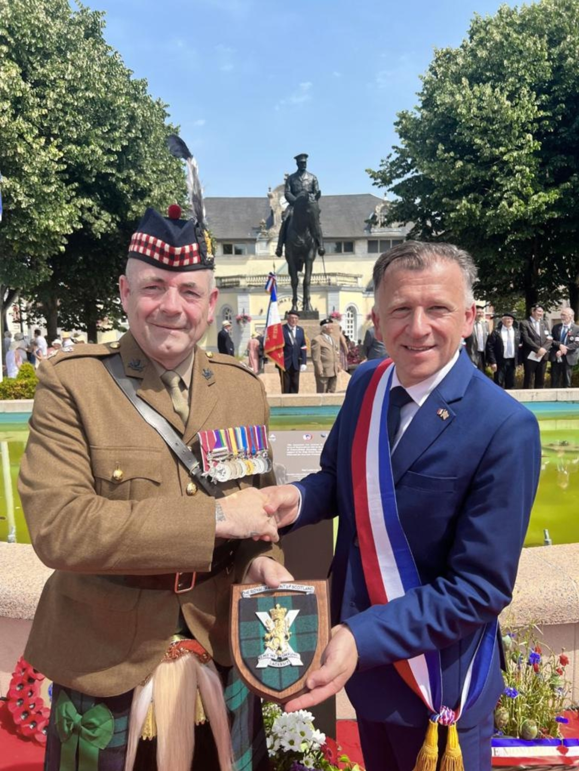
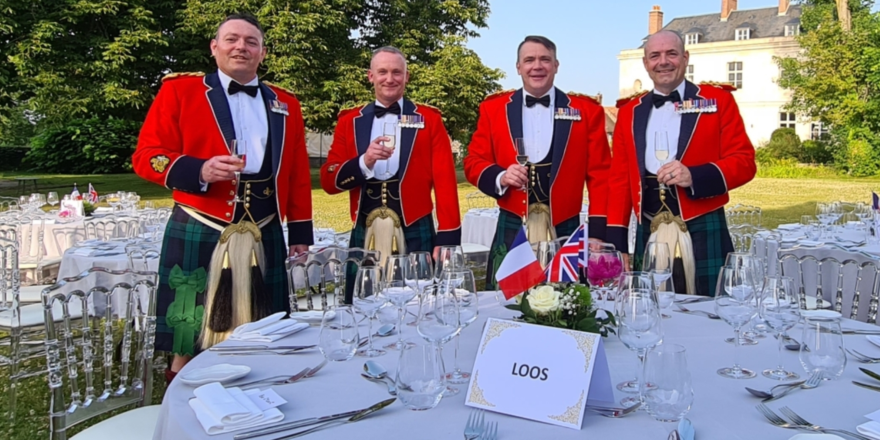
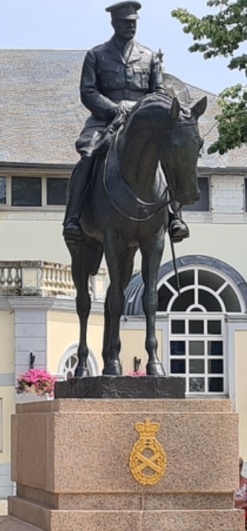
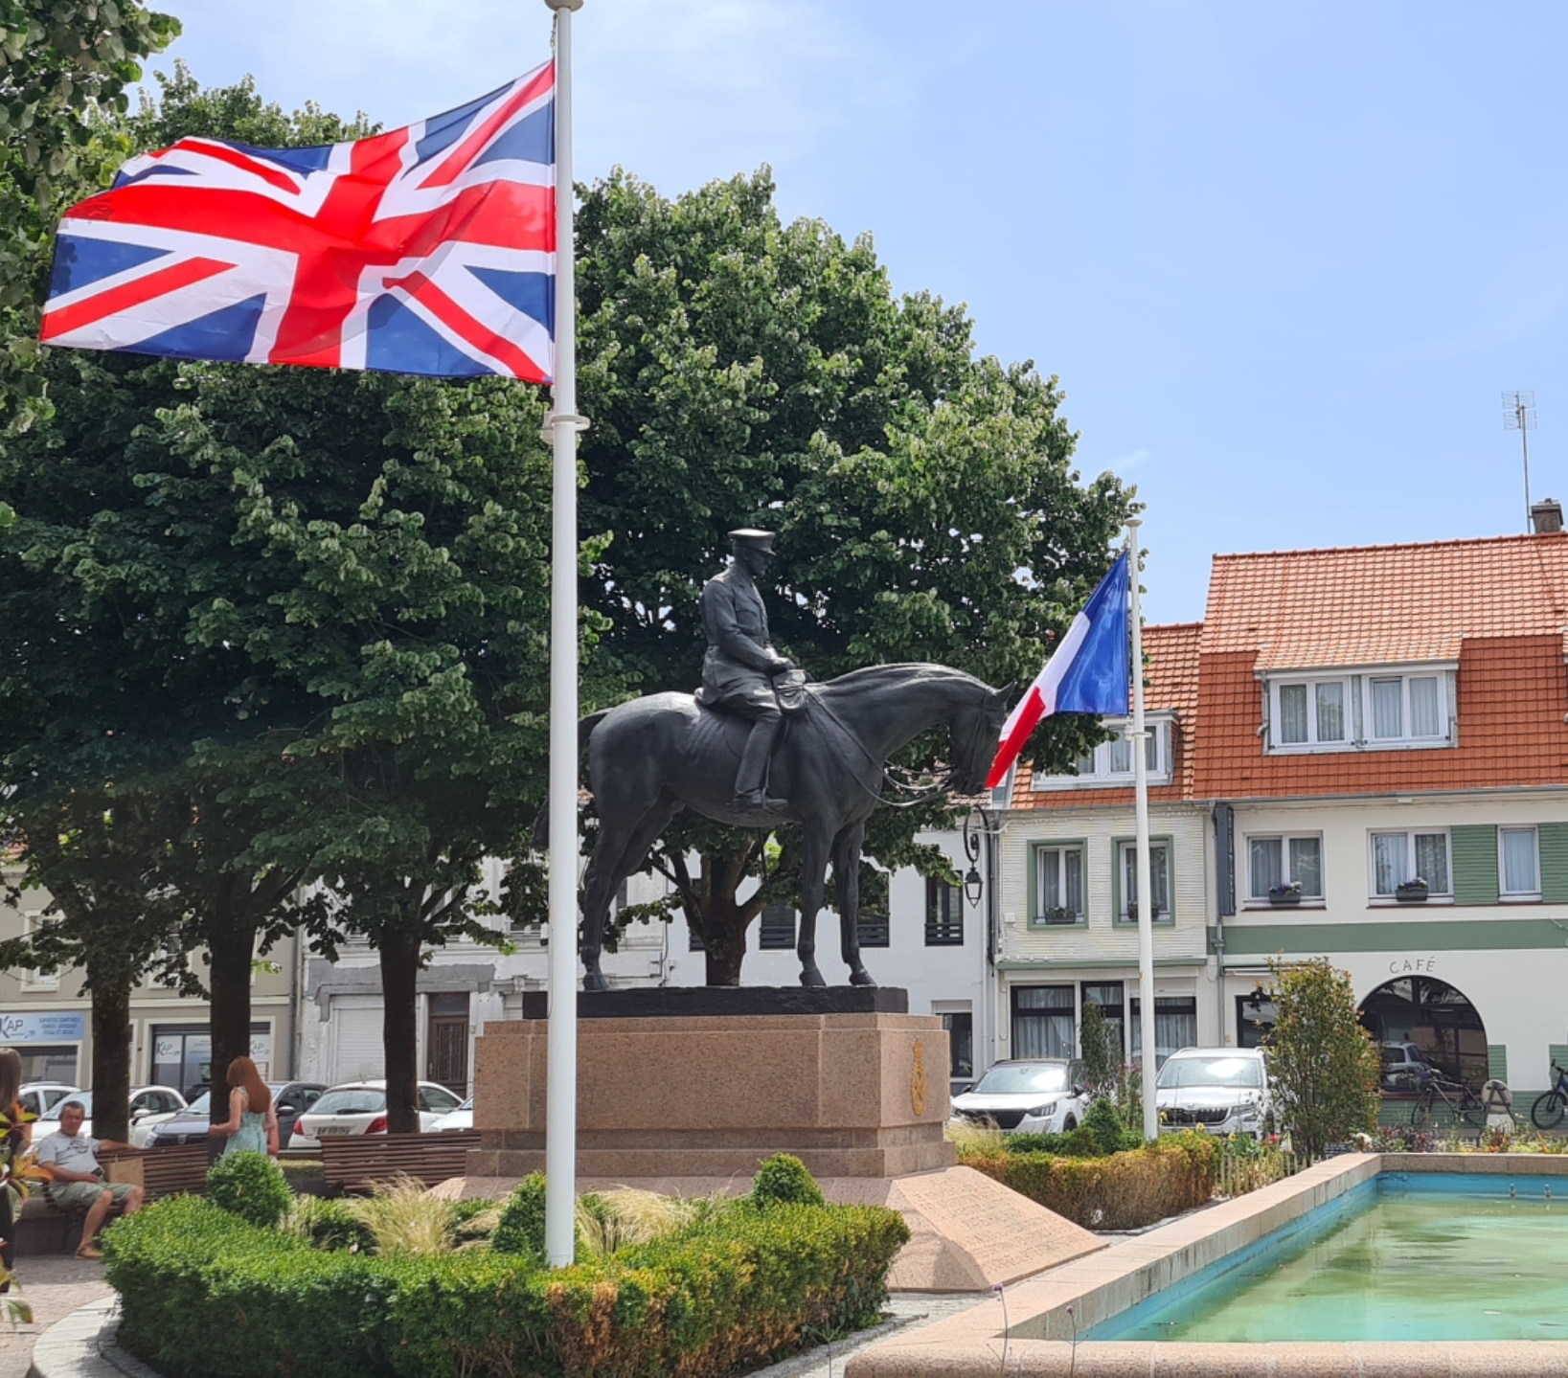
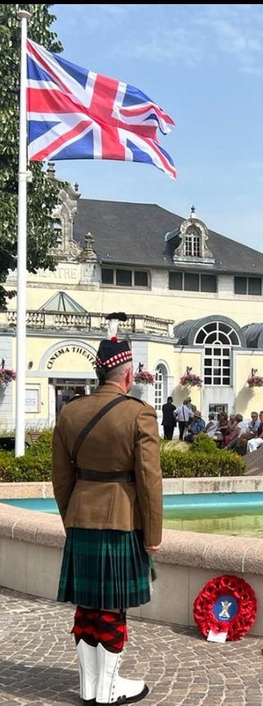
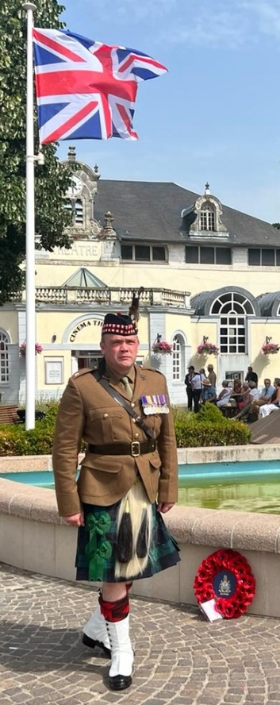
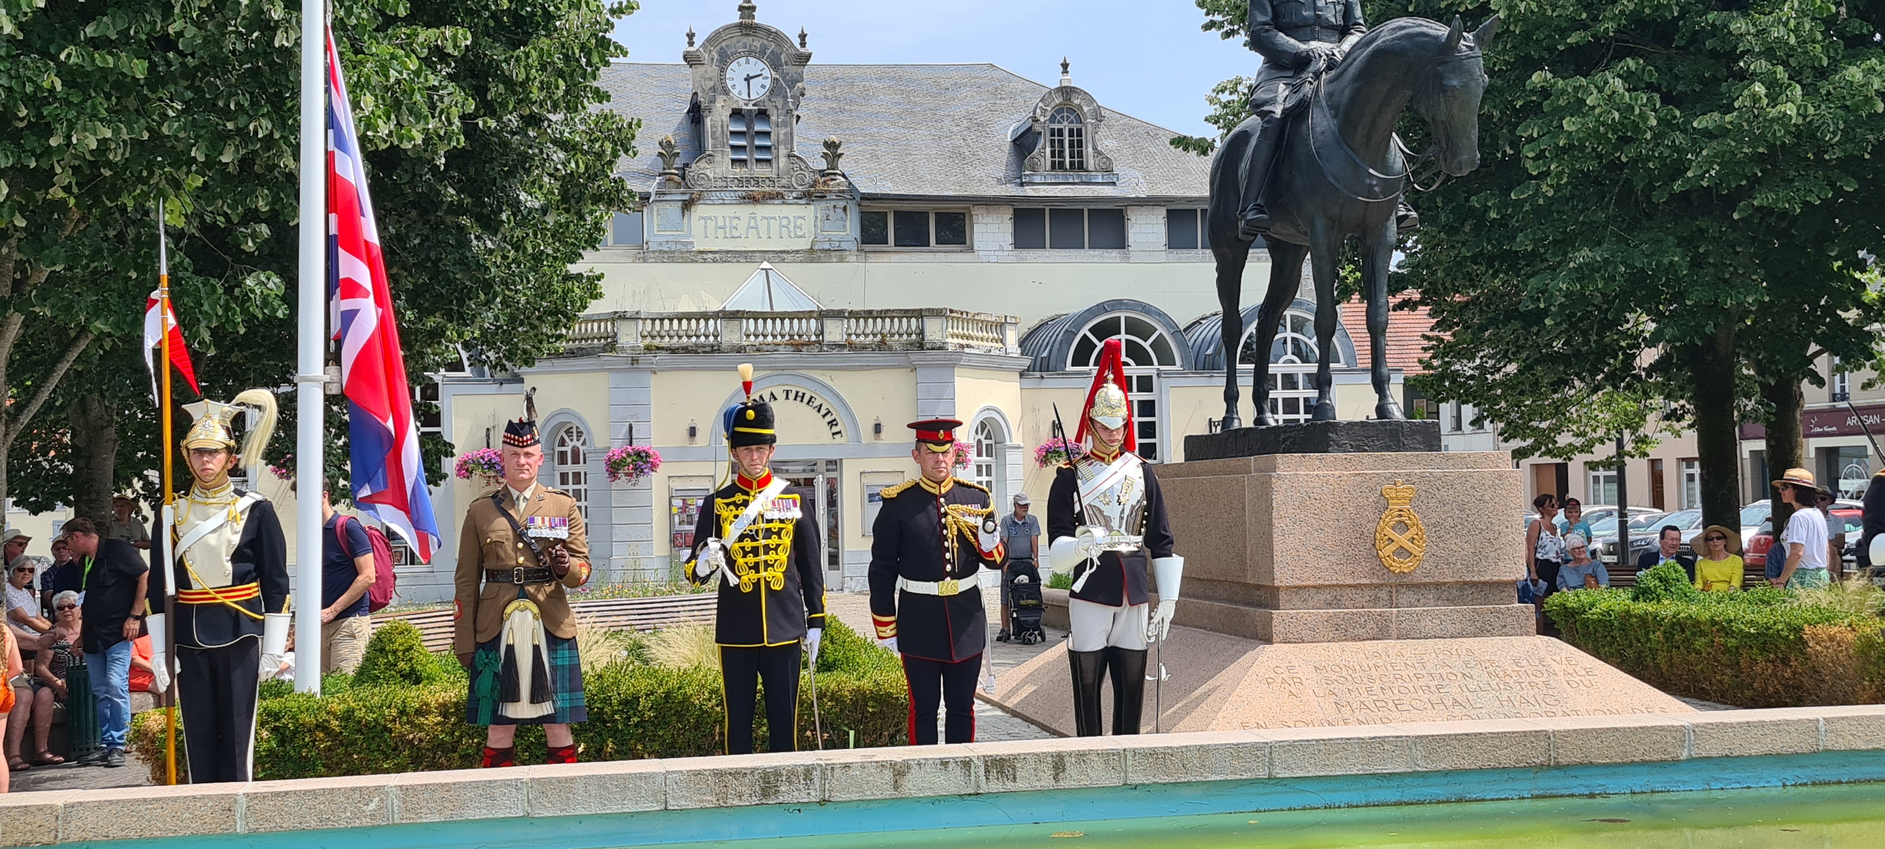
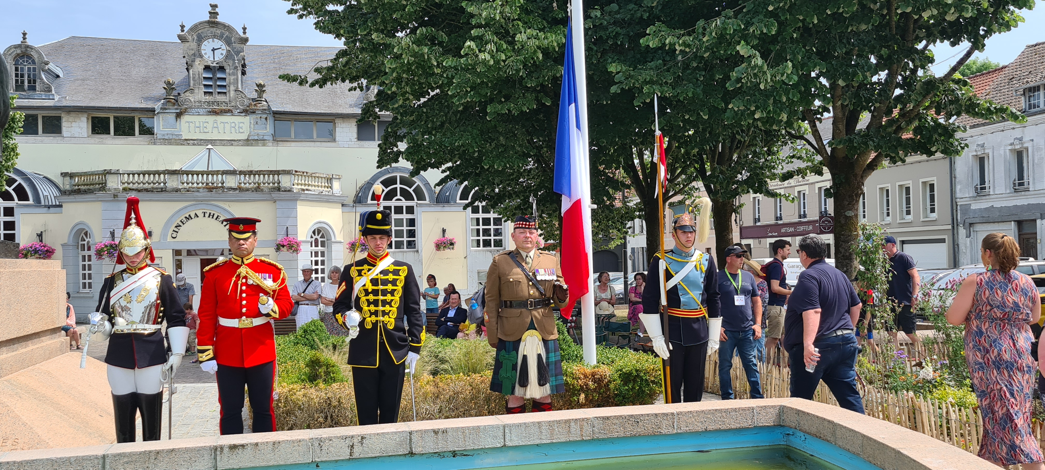
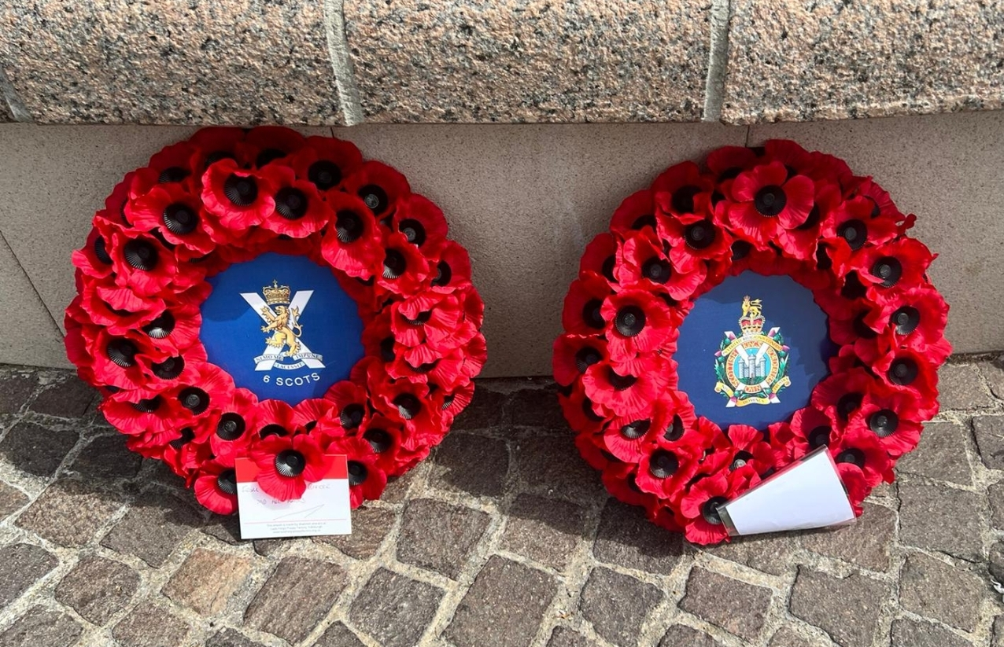
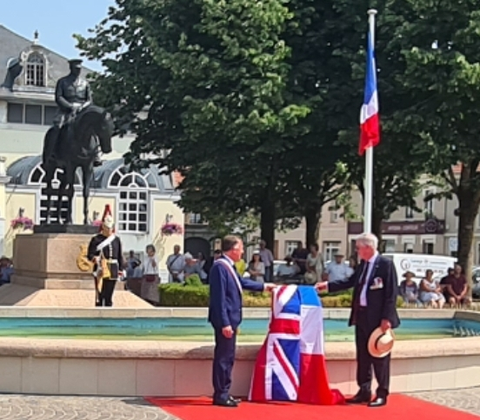
6 SCOTS
Who | 6 SCOTS
What | Commemorating the restoration of the statue of Field Marshall Haig
Where | Montreuil-sur-Mer in France
When | 17 - 19 June 22
Montreuil-sur-Mer – The home of the General Headquarters of the British Armies in France and Belgium (GCHQ) during the First World War under Field Marshall Haig
CO 6 SCOTS and Mayor of Montreuil-sur-Mer
CO, QM, RSM 6 and 7 SCOTS at Gala Dinner
For three years, from March 1916 to April 1919, the inhabitants of Montreuil-sur-Mer were involved in a daily entente cordiale with the several thousand British troops stationed there.
FM Haig – Centre of Montreuil-sur-Mer

